Slide 1



01
Presented By
Omar Masuud & Remaz Obeeaa
Supervised By
Dr. Fadi Ibrahim

Slide 2
02
ntroduction
I
With the rapid pace of technological advancement and the growing reliance on digital solutions to streamline various aspects of daily life, the need for developing systems that effectively connect service providers with clients has become increasingly critical. Based on this need, our project was developed: a platform for booking appointments with technicians and tradespeople. The platform aims to enhance communication between clients and professionals across multiple specialties by providing a flexible and efficient digital environment that enables both parties to seamlessly manage booking, payment, and evaluation processes.

Slide 3
03
mportance
I
Effective communication
Many customers struggle to find reliable technicians who arrive on time, and tradespeople often lack the necessary tools to manage orders and appointments.
Therefore, the need arose for an online platform that connects both parties and provides a comprehensive system for managing bookings and communicating professionally.
Market opportunity
Improving user experience

Slide 4
تمكين العملاء من تقييم الخدمات وتحسين جودة الأداء.
oals
04
G
1
2
3
4
Supporting technicians in managing their work and appointments effectively.
Facilitating the search for specialized technicians in various fields.
Providing a user-friendly interface for all parties.
Enabling customers to evaluate services and improve performance quality.

Slide 5




ctors
05
A
Customers
Technicians
Administration
Bank system

Slide 6
07
ethodology
M
Scrum is an Agile framework used to manage and develop software projects through short, iterative cycles called sprints. It focuses on flexibility, continuous improvement, and frequent delivery of working features.
This methodology helps maintain a structured workflow, ensuring high-quality deliverables with fewer errors.

Slide 7
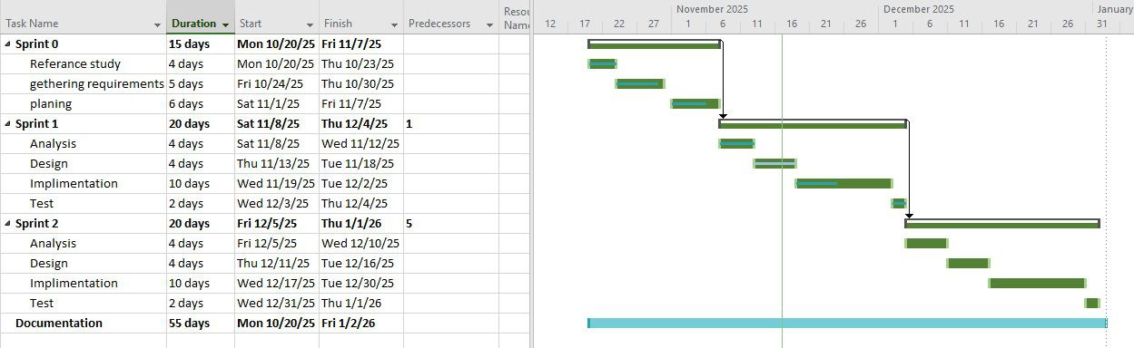
08
P
roject Implementation Plan

Slide 8
09
eference study
R
TaskRabbit
· Strengths: Flexible selection by price/skills - Modern interface
· Weaknesses: Some services lack warranty - Complex registration
Handy
· Strengths: Transparent pricing - Effective customer support
· Weaknesses: Focused on cleaning - Limited geographic coverage
Maharah.net
· Strengths: Arabic support - Comprehensive craft fields
· Weaknesses: Limited technicians in some areas - UX needs improvement
Key Takeaways for Project:
· Need for extensive technician database
· Reliable rating system
· Simplified user interface
· Local support with wide geographic coverage
· Integrated electronic payment
· Quick customer support response

Slide 9
10
T
echnologies used
Frameworks and Library
Programming languages
Tools
Html
Css
Type Script
Php
Mysql
Vite
Laravel
React.js
Zustand
Git
JWT
API

Slide 10
11
rchitecture Used
A
We adopted a clint server with Three-Tier Web Architecture consisting of:
Presentation Layer (React): Handles the user interface and communicates with the backend through REST APIs.
Application Layer (Laravel): Processes all business logic, authentication, booking management, and system rules.
Data Layer (MySQL): Stores all system data including users, technicians, appointments, and reviews.
Why We Used This Architecture
Provides a clear separation of concerns, making the system easier to develop and maintain.
Fully compatible with our chosen technologies: React + Laravel + MySQL.
Supports organized, scalable, and secure web application development.
Ideal for academic projects due to its clarity, structure, and ease of documentation.

Slide 11
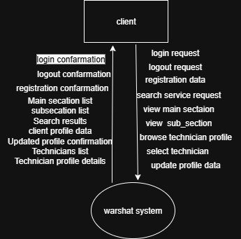

Slide 12
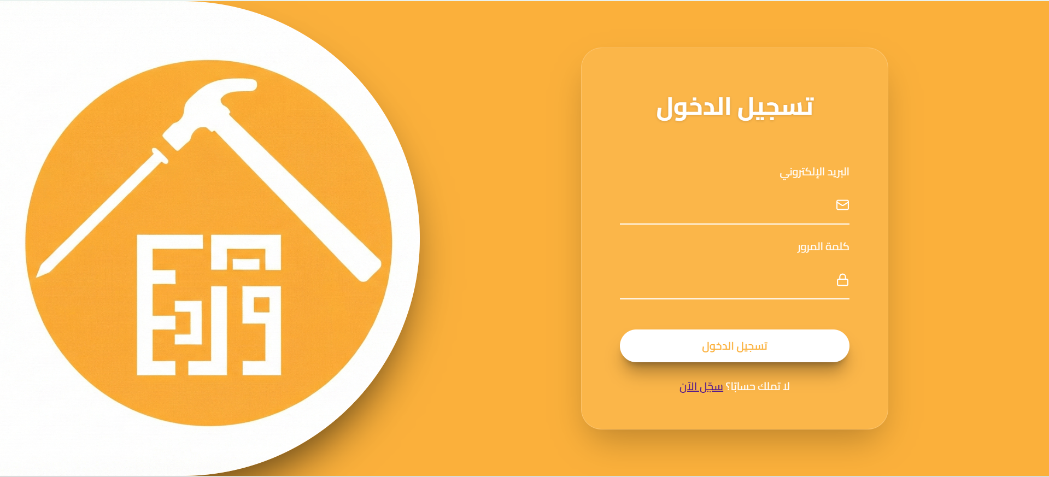

Slide 13
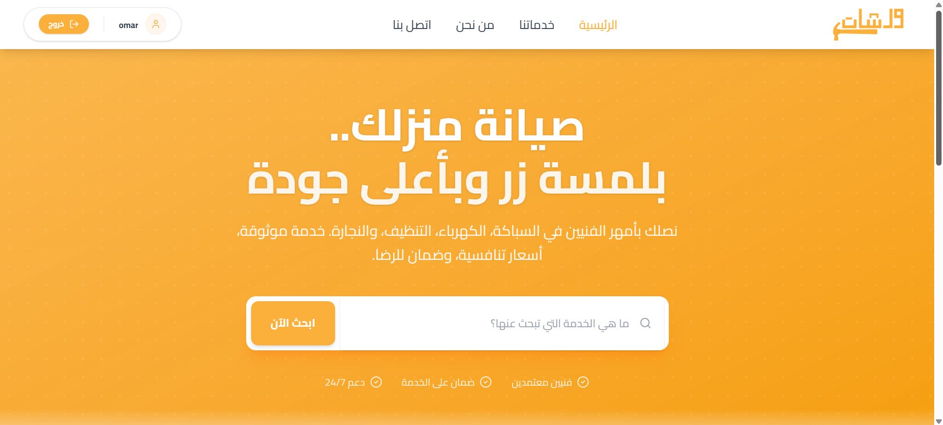

Slide 14
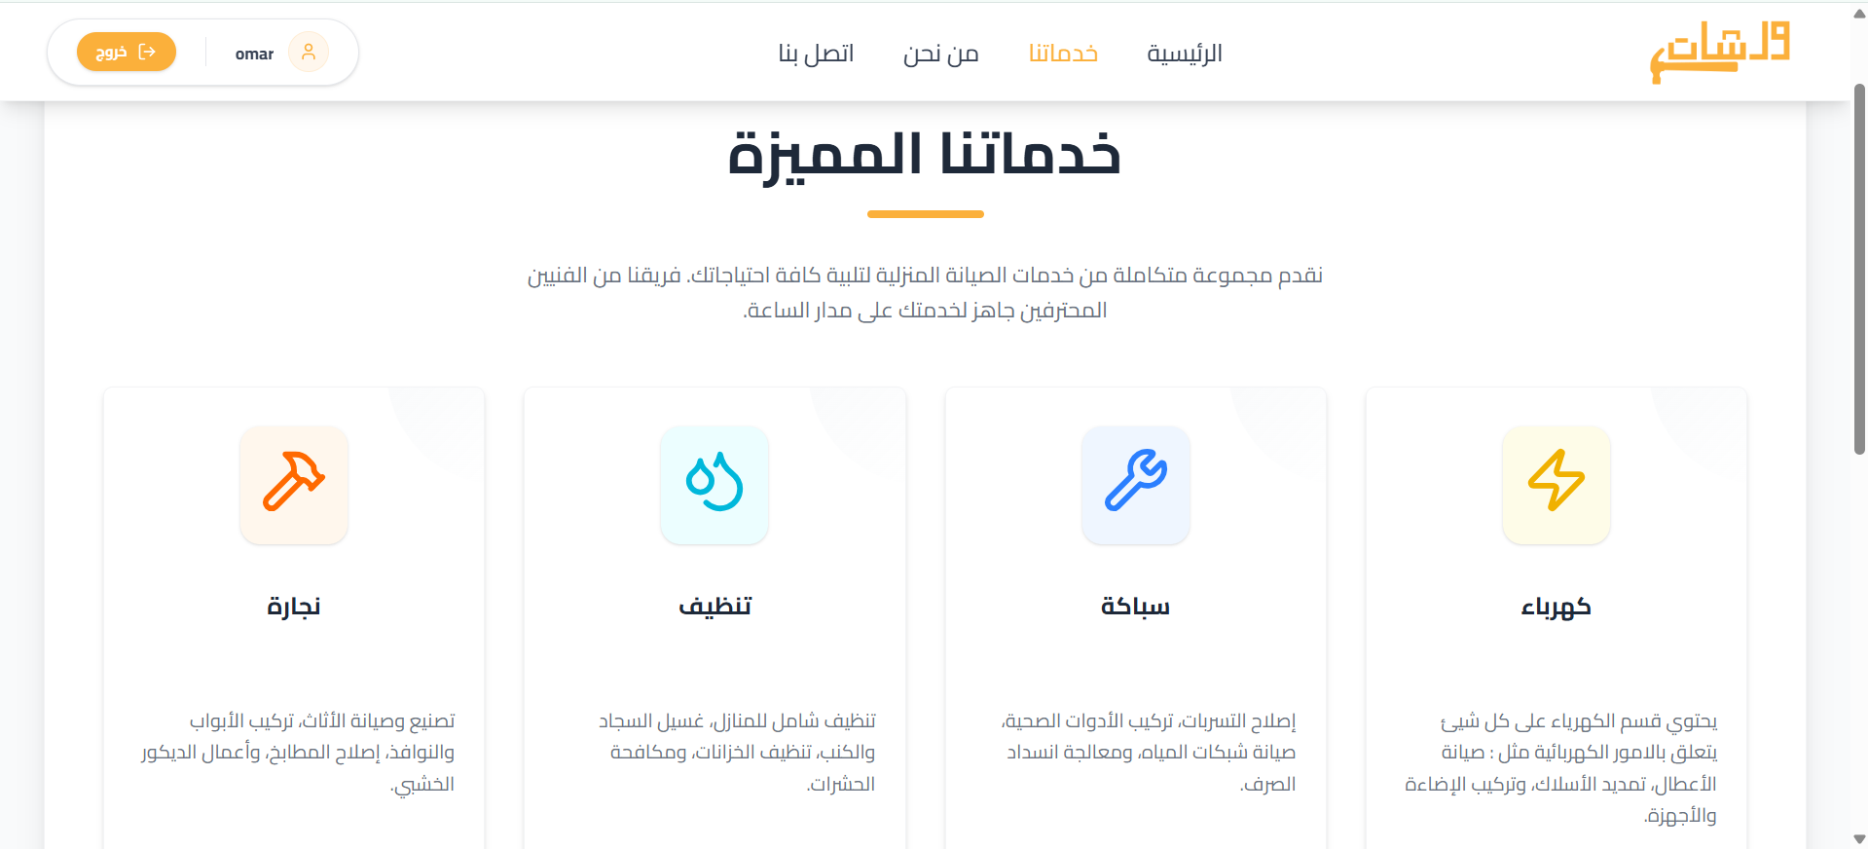

Slide 15
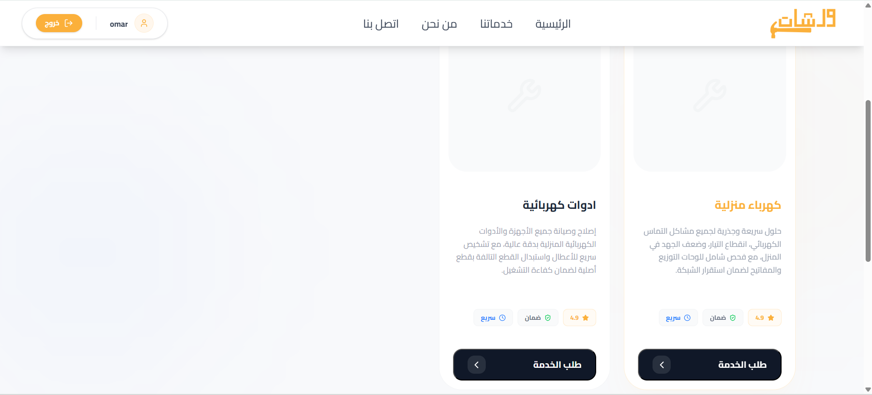
11

Slide 16
12
Thank
You

